Slide 1

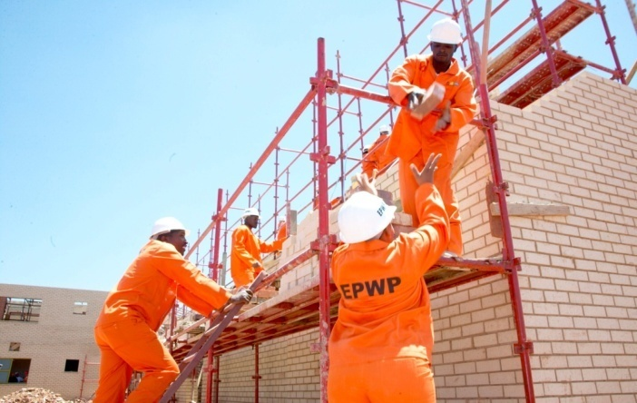
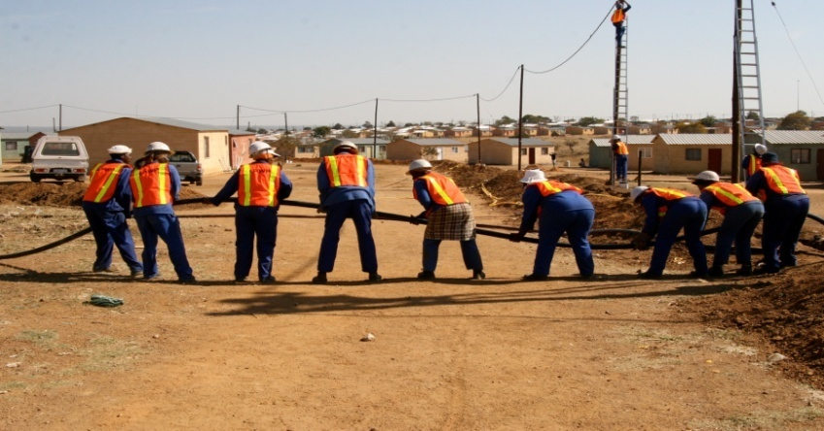
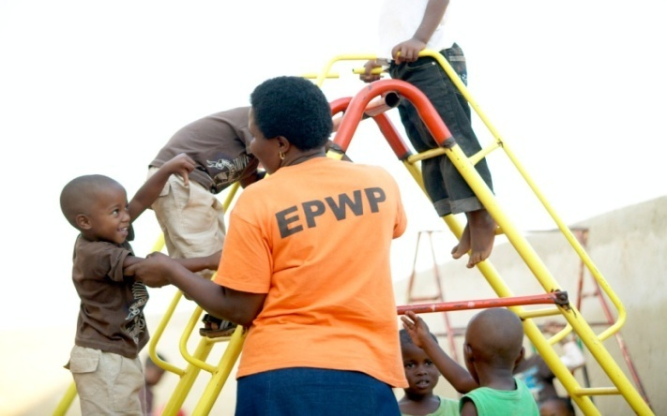
Expanded Public Works Programme
6th EPWP Summit
13 – 14 November 2016
EPWP Monitoring, Evaluation and Reporting

Slide 2

Presentation Outline
Performance against EPWP Phase 3 targets
Performance in 2018-19
  Performance to date against EPWP Phase 3 targets per sector
  Q2 2018/19 performance against annual targets
  Provincial performance against annual targets
  Demographic performance
  Financial Indicators
Sample of current project outputs
Spatial distribution of projects
EPWP Training Performance

Slide 3
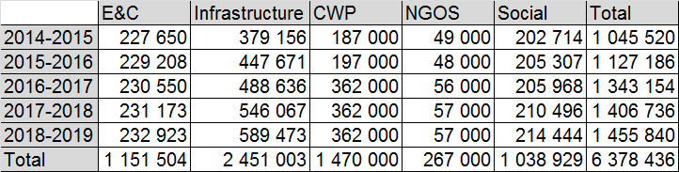
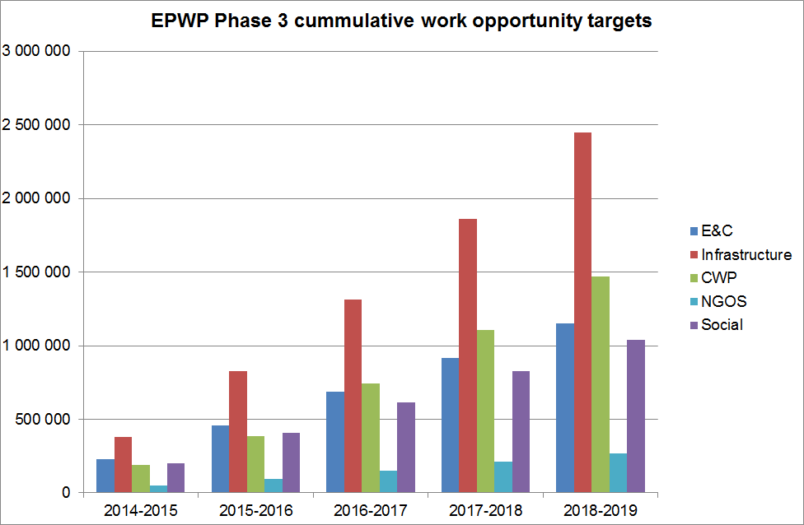
EPWP Phase 3 WO targets

Slide 4
Performance against 5-year WO targets by sector
By the end of Q2 2018_19 the programme achieved 4.3 million work opportunities against the 5 year target which translates to 72% of the 6 million target. Overall, the EPWP has a shortfall of 2 075 117 WO to achieve the 5 year target. The least performing sectors are the Infrastructure sector and the Non-State Community Works Programme, at 56.5% and 62.1% respectively.

Slide 5
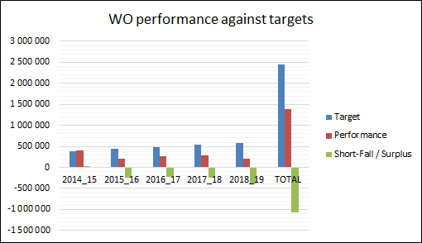
Infrastructure Sector Performance
The infrastructure sector reported a total of 1 385 491 work opportunities to date against the 2,4 million work opportunities. This translates to 57% of the 5-year target.
The sector has a total shortfall of 1 065 512 work opportunities against the 5-year target.
FY | Target | WO Reported | Shortfall / Surplus | % Achieved
2014_15 | 379 156 | 409 209 | 30 053 | 108%
2015_16 | 447 671 | 202 481 | -245 190 | 45%
2016_17 | 488 636 | 263 510 | -225 126 | 54%
2017_18 | 546 067 | 294 041 | -252 026 | 54%
2018_19 (q2) | 589 473 | 216 250 | -373 223 | 37%
Total | 2 451 003 | 1 385 491 | -1 065 512 | 57%

Slide 6
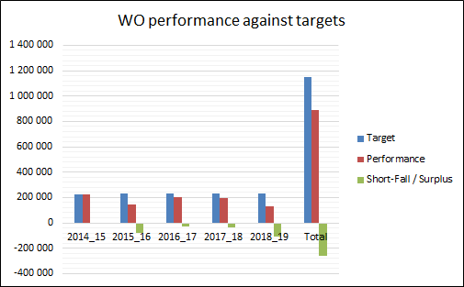
Environment and Culture Sector Performance
The Environment and Culture sector reported a total of 891 497 work opportunities to date against the 1,1 million work opportunities. This translates to 77% of the 5-year target .
The sector has a total shortfall of 260 007 work opportunities.
FY | Target | WO Reported | Shortfall / Surplus | % Achieved
2014_15 | 227 650 | 221 090 | -6 560 | 97%
2015_16 | 229 208 | 147 785 | -81 423 | 64%
2016_17 | 230 550 | 200 281 | -30 269 | 87%
2017_18 | 231 173 | 195 193 | -35 980 | 84%
2018_19 (q2) | 232 923 | 127 148 | -105 775 | 55%
Total | 1 151 504 | 891 497 | -260 007 | 77%

Slide 7
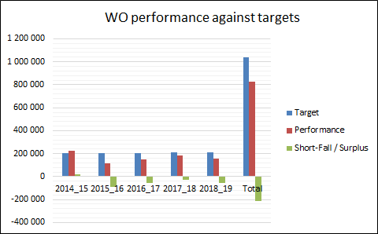
Social Sector Performance
The Social sector reported a total of 828 227 work opportunities to date against the 1 million work opportunities. This translates to 80% of the 5-year target.
The sector has a total shortfall of 210 702 work opportunities..
FY | Target | WO Reported | Shortfall / Surplus | % Achieved
2014_15 | 202 714 | 224 606 | 21 892 | 111%
2015_16 | 205 307 | 113 371 | -91 936 | 55%
2016_17 | 205 968 | 149 006 | -56 962 | 72%
2017_18 | 210 496 | 185 145 | -25 351 | 88%
2018_19 (q2) | 214 444 | 156 099 | -58 345 | 73%
Total | 1 038 929 | 828 227 | -210 702 | 80%

Slide 8
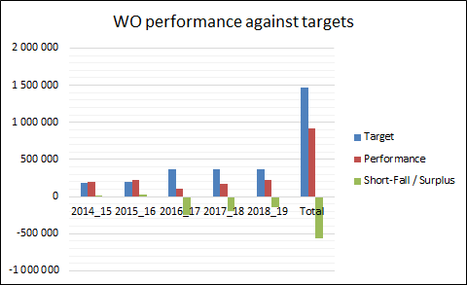
Community Works Programme
The Non-state sector Community Works Programme reported a total of 912 412 work opportunities to date against the 1,4 million work opportunities, which translates to 62% of the 5-year target.
The sector has a total shortfall of 557 588 work opportunities to achieve the 5 year target.
FY | Target | WO Reported | Shortfall / Surplus | % Achieved
2014_15 | 187 000 | 198 707 | 11 707 | 106%
2015_16 | 197 000 | 221 375 | 24 375 | 112%
2016_17 | 362 000 | 107 318 | -254 682 | 30%
2017_18 | 362 000 | 166 264 | -195 736 | 46%
2018_19 (q2) | 362 000 | 218 748 | -143 252 | 60%
Total | 1 470 000 | 912 412 | -557 588 | 62%

Slide 9
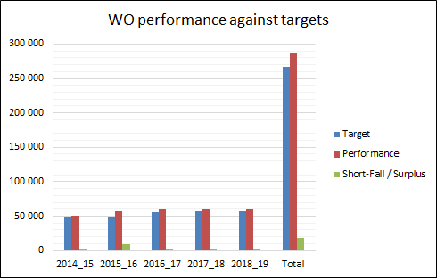
Non-Profit Organizations (NPOs)
The Non-state sector Non-Profit Organizations reported a total of 285 692 work opportunities to date against the 267 000 work opportunities target. This translate to 107% of the 5-year target.
The sector reported a surplus of 18 692 work opportunities.
FY | Target | WO Reported | Shortfall / Surplus | % Achieved
2014_15 | 49 000 | 50 371 | 1 371 | 103%
2015_16 | 48 000 | 56 528 | 8 528 | 118%
2016_17 | 56 000 | 59 130 | 3 130 | 106%
2017_18 | 57 000 | 59 591 | 2 591 | 105%
2018_19 (q2) | 57 000 | 60 072 | 3 072 | 105%
Total | 267 000 | 285 692 | 18 692 | 107%

Slide 10
Performance in 2018/19

Slide 11
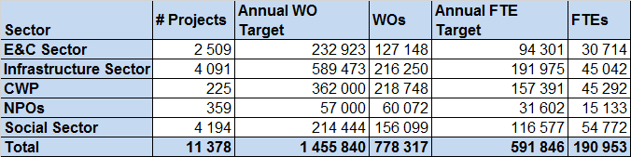
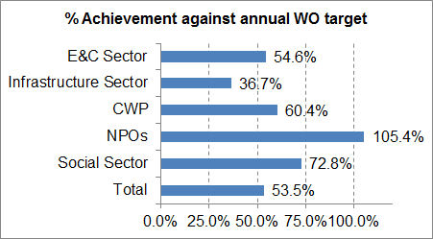
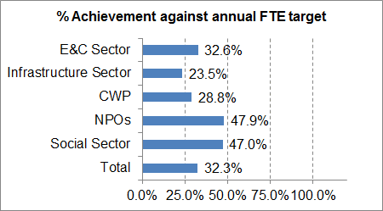
Overall Performance against annual work opportunity targets by sector (Q2 2018_19)

Slide 12
Discussion on Performance
(Sector performance against annual targets)
The EPWP Programme created 778 318 work opportunities (WOs) during the current financial year (1 April 2018 – 30 September 2019). This translate to 53.5% of the annual work opportunity target.
190 953 Full-Time Equivalents (FTEs) were created against the set target of 519 846, translating to 32.3% of the annual FTE target.
The Non-State sector Non-Profit Organizations (NPOs) have over achieved the annual target of 57 000 WOs. The programme reported 60 072 WOs which translates to 105% of the target.
The least performing sector is the infrastructure sector, reporting 36.7% of the target by the end of Q2.

Slide 13
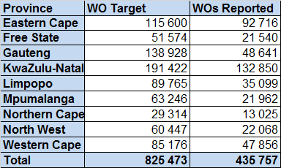
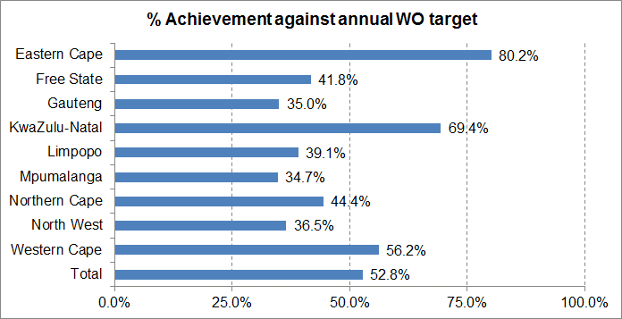
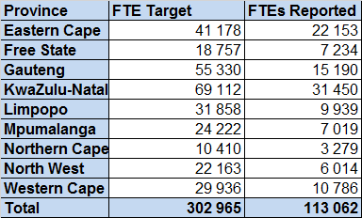
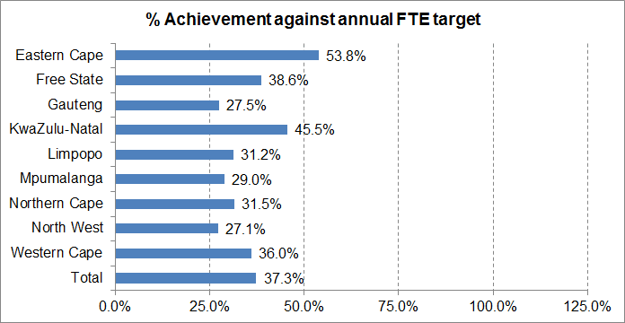
Performance against annual (municipal and provincial) work opportunity targets (Q2 2018_19)

Slide 14
Discussion on Performance
(Provincial performance against annual targets)
The provincial and municipal spheres combined reported 52.8% against the annual work opportunity target of 825 473 and 37.3% against the FTE target of 302 965.
The Eastern Cape Province is leading in terms of performance against the annual work opportunity target. The province has reported 80.2% of the target during the period 1 April 2018 – 30 September 2018.
The least performing province is Mpumalanga, reporting 34.7% against the annual work opportunity target by the end of Q2.
The next slide gives a breakdown of performance for each of the spheres in the provinces.

Slide 15
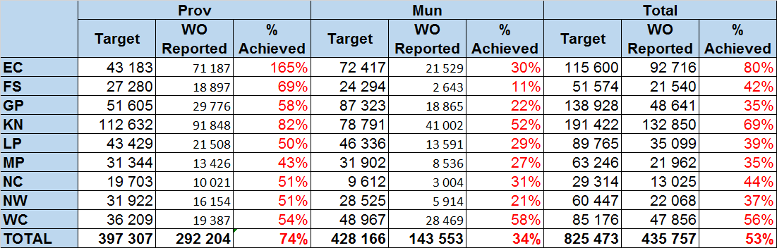
Performance against annual (municipal and provincial) work opportunity targets (Q2 2018_19)

Slide 16
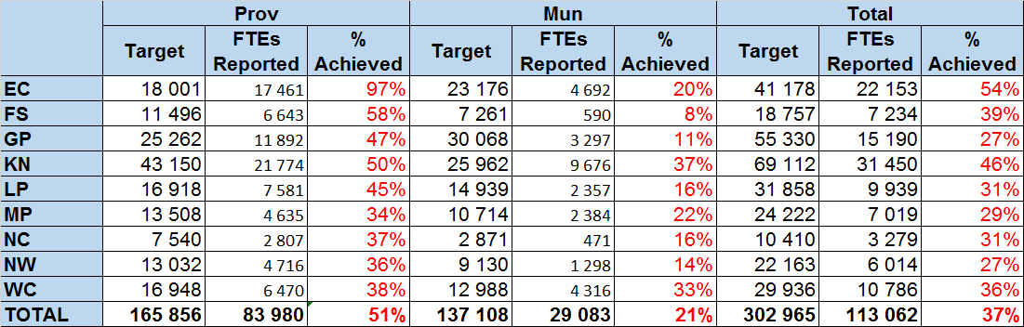
Performance against annual (municipal and provincial) full-time equivalence targets (Q2 2018_19)

Slide 17
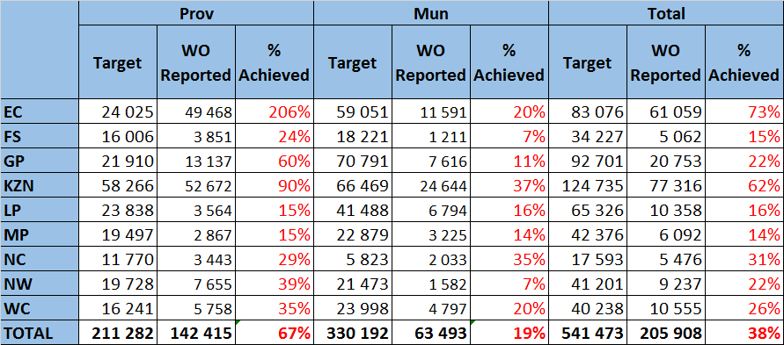
Performance against annual (municipal and provincial) work opportunity targets (Q2 2018_19)
Infrastructure Sector

Slide 18
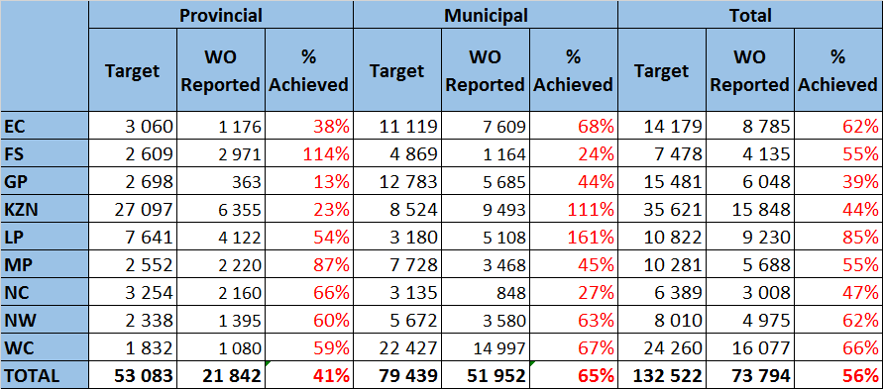
Performance against annual (municipal and provincial) work opportunity targets (Q2 2018_19)
Environment & Culture Sector

Slide 19
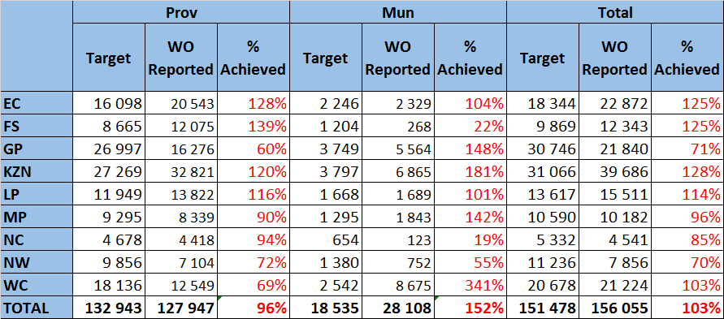
Performance against annual (municipal and provincial) work opportunity targets by sector (Q2 2018_19)
Social Sector

Slide 20
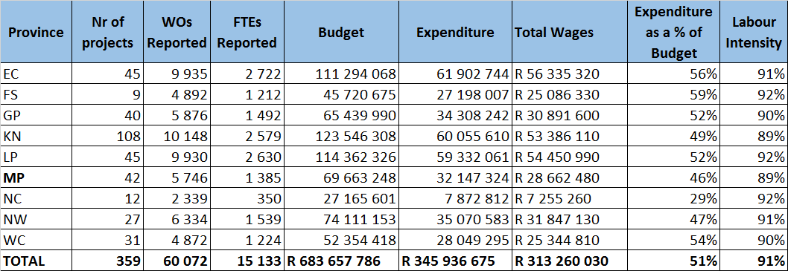
Performance per Province
Non-Profit Organizations (NPOs)
Q2 2018_19

Slide 21
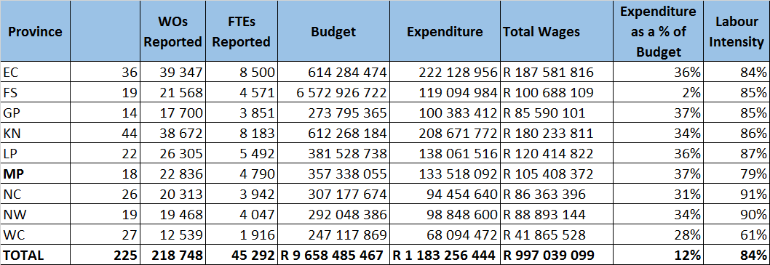
Performance per Province
Community Works Programme (CWP)
Q2 2018_19

Slide 22
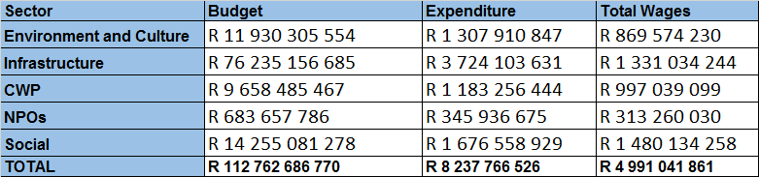
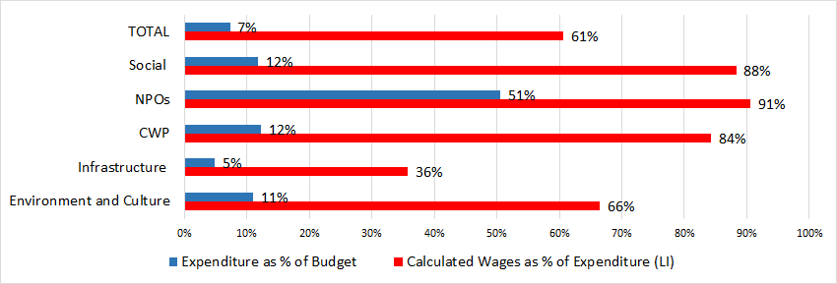
Financial Indicators

Slide 23
Spatial distribution of projects

Slide 24
Presentation Outline (Q2 1819)
Progress against targets
Districts and Metropolitan Munics (WO)
Districts and Metropolitan Munics (FTE)
Progress against targets
Local and Metropolitan Munics (WO)
Local and Metropolitan Munics (FTE)

Slide 25
District & Metro Municipal Progress
Contains maps of municipal progress for Quarter 2 2018-19 for the period 1 April 2018 – 30 Sept 2018.
On a linear scale municipalities should have achieved 50% of their annual targets.
All the municipalities in RED on the maps have not reached 25% yet while municipalities in ORANGE have not achieved 50% yet. So areas in RED and ORANGE need to improve if they aim to reach their target.
Municipalities with no colour did not report this quarter.
The following Districts did not report this quarter:

Slide 26
Metro Municipal Progress
eThekwini metro in KZN reached > 50% of WO target and 44% of FTE target. (thus YELLOW in the WO map but ORANGE in the FTE map)
3 metros achieved above 25% but below 50% ito WO targets, namely City of Cape Town, Nelson Mandela Bay Metro and City of Johannesburg (thus ORANGE on the WO map) but they all achieved less than 25% of their FTE targets (thus RED in the FTE map).
All other metros achieved below 25% ito WO and FTE targets.
The poorest performing metro is Mangaung.

Slide 27
District Municipal Progress
The 3 District municipalities in the table below reached > 100% of their annual WO target.
Gert Sibande in Mpumalanga also achieved > 100% of their FTE target.
Overberg district in the Western Cape needs to increase the duration of their work opportunities if they want to reach their FTE target.
(Green areas on the WO and FTE progress map per District & Metro represent districts which exceeded their WO and FTE targets)

Slide 28
District Municipal Progress
The following 8 Districts are on track by achieving more than 50% but less than 100% of their WO targets (YELLOW and BLUE areas on the WO map).
Nkangala District also achieved 79% of their FTE target (thus BLUE on the FTE map).
Garden Route and Zululand District achieve more than 50% of their FTE targets as well (YELLOW on the FTE map)
The other districts need to pay attention to the duration of their work opportunities to reach their FTE targets.

Slide 29
District Municipal Progress
19 Districts did not reach 25% of their WO targets (RED areas on the map) (excluding the 2 districts that did not report)
These municipalities will have to improve reporting if they are to reach their WO and FTE targets.

Slide 30
Colours on maps

Slide 31
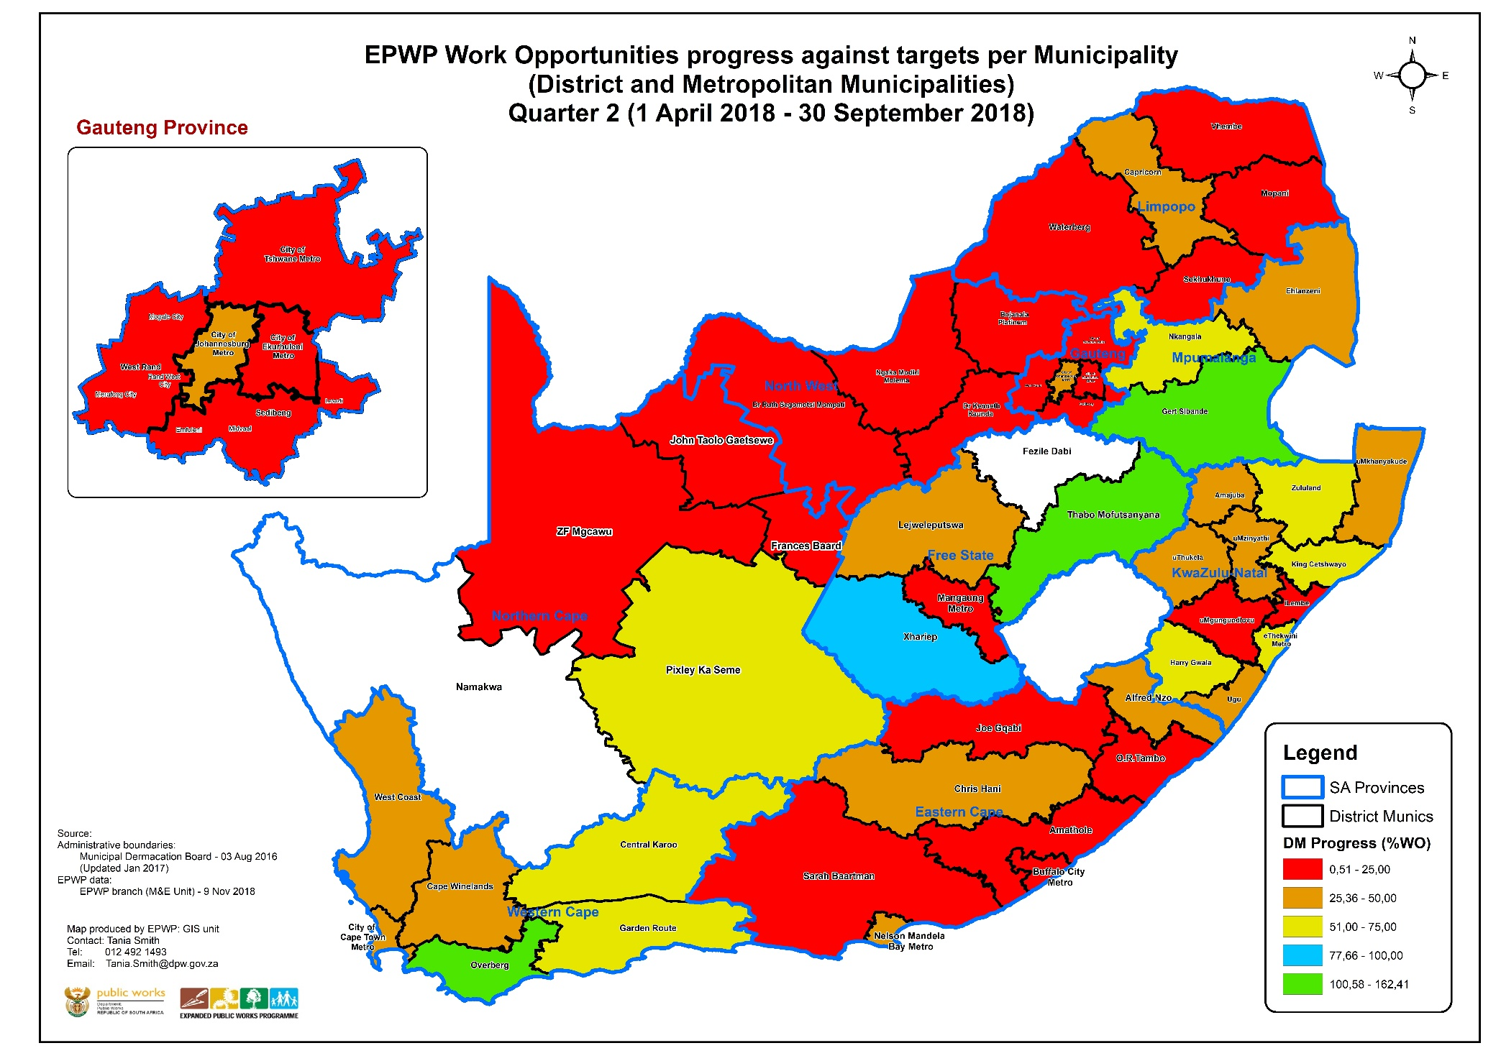
WO progress against targets: DM & Metros (Q2)

Slide 32
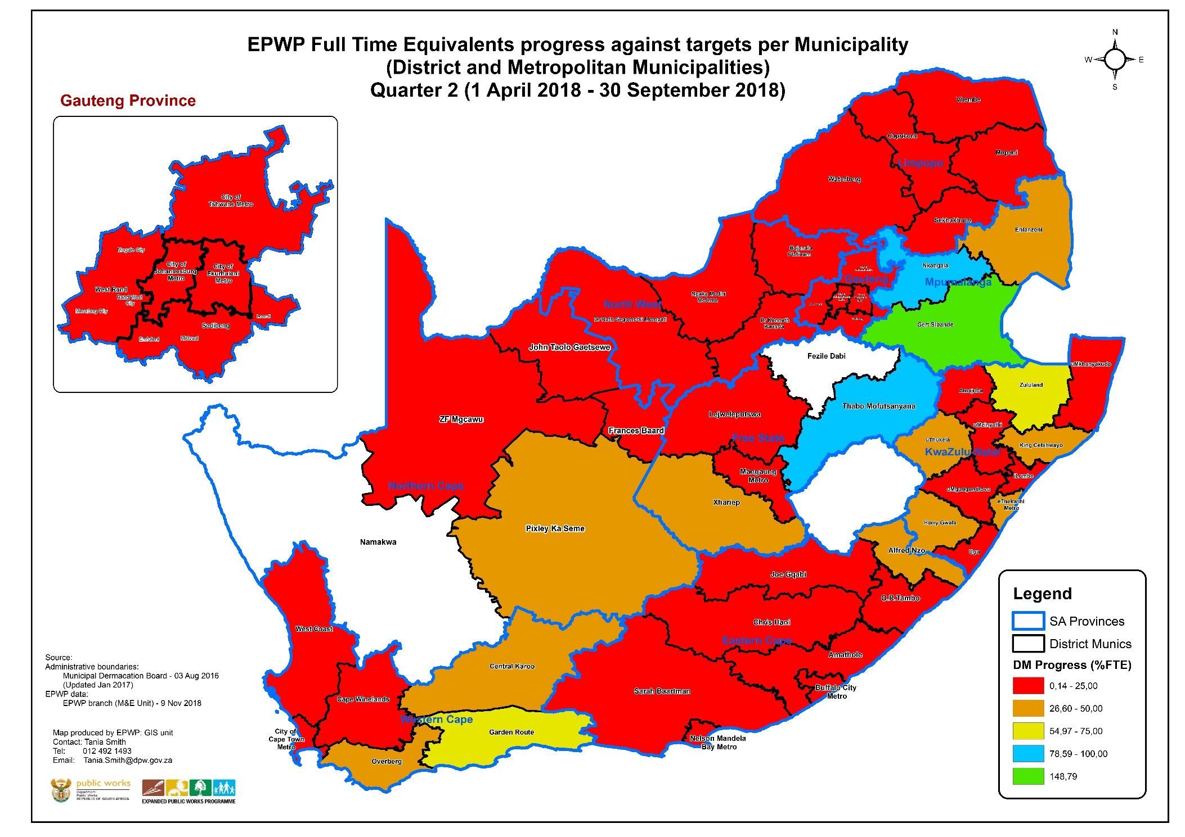
FTE progress against targets: DM & Metros (Q2)

Slide 33
Local Municipal Progress
During Q1 2018-19 fourteen(14) local municipalities did not report.
This quarter only the following 3 local municipalities did not report:

Slide 34
Local Municipal Progress
19 local municipalities reached more than 100% of their WO targets (areas in GREEN on WO map): 12 of these are situated in the WC, 3 in KZN, 2 in NC and 1 each in EC and FS.
Cape Agulhus, Drakenstein and Saldanha Bay local municipalities (all in WC) also achieved more than 100% of their FTE targets.
30 local municipalities reached more than 75% their annual WO target but less than 100% (areas in Blue on the WO). Previous quarter this figures was only 7 local municipalities. Most of these are situated in KZN (13) and WC (7).
37 local municipalities reached more than 50% but less than 75% of their annual WO target (all the areas in Yellow on the WO). Most are situated in KZN (11), followed by EC (with 9) and WC and LP (5 each).
Areas in Orange represent areas where municipalities reached more than 25% but less than 50% of their targets. 63 local municipalities fall in this group ito WO targets and 57 local municipalities ito FTE targets (Orange areas in WO and FTE maps).
53 local municipalities did not reach 25% of their WO targets (all the areas in RED on the WO) while 97 local municipalities did not reach 25% of their FTE targets (all area in RED in the FTE map).

Slide 35
Local Municipal Progress: < 25% of WO target
The spatial spread of the 53 local municipalities with less than 25% of their WO are as follows amongst the provinces: (this excludes the 3 local municipalities that did not report)

Slide 36
Top 20 Local Munics in terms of WOs reported

Slide 37
Top 20 Local Munics in terms of FTEs reported

Slide 38
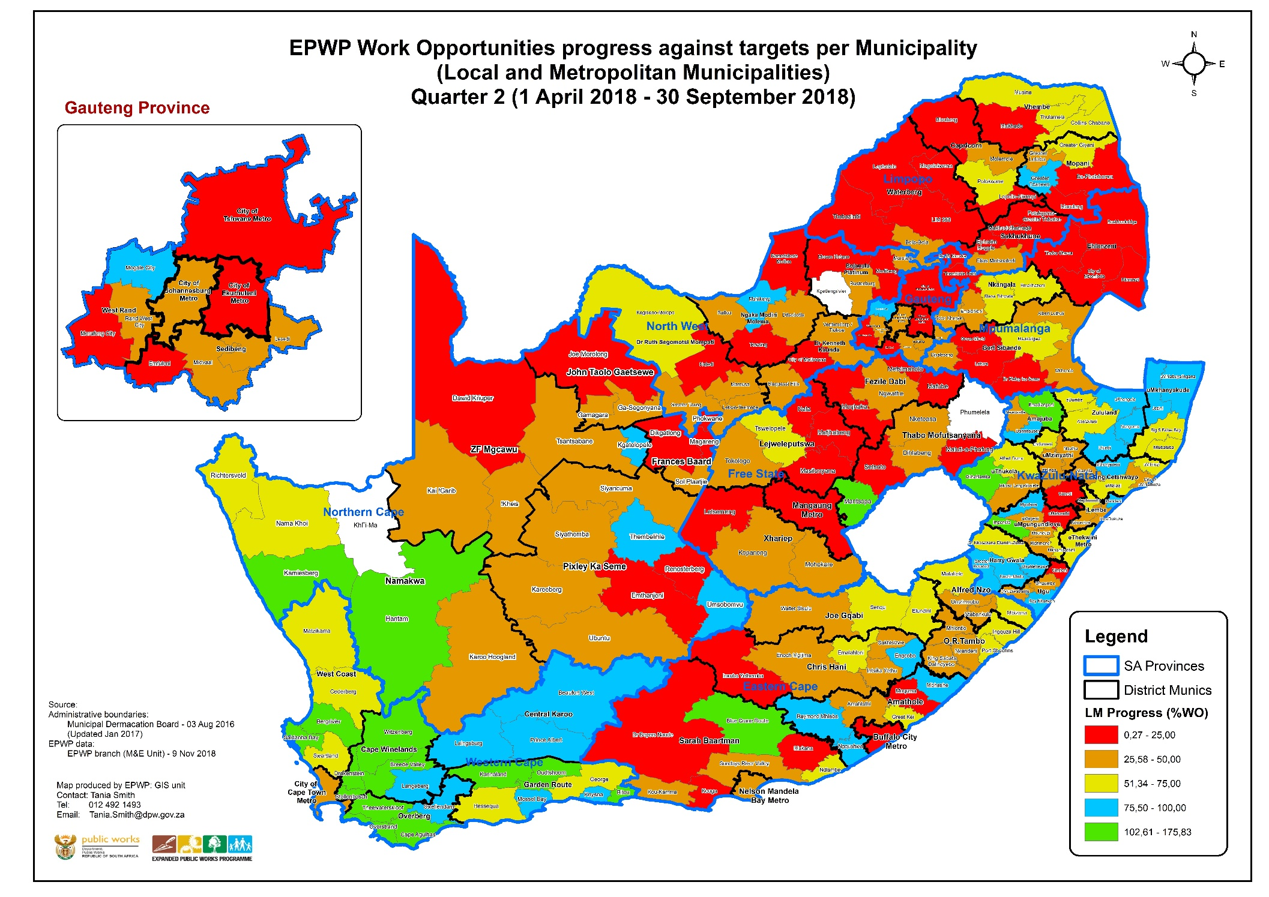
WO progress against targets: LM & Metros (Q2)

Slide 39
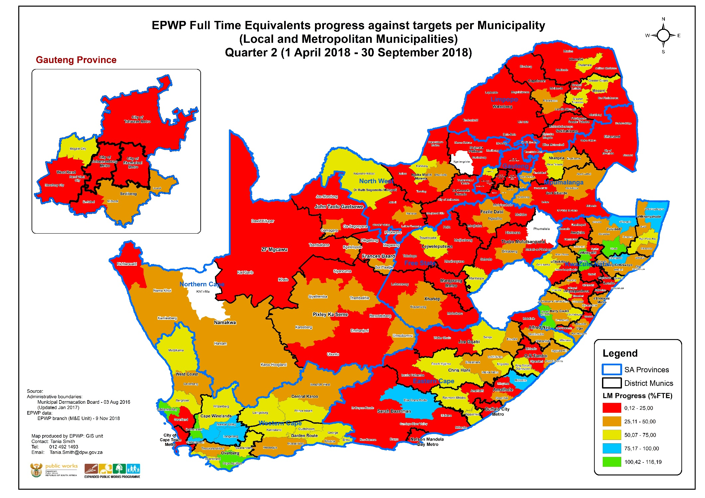
FTE progress against targets: LM & Metros (Q2)

Slide 40
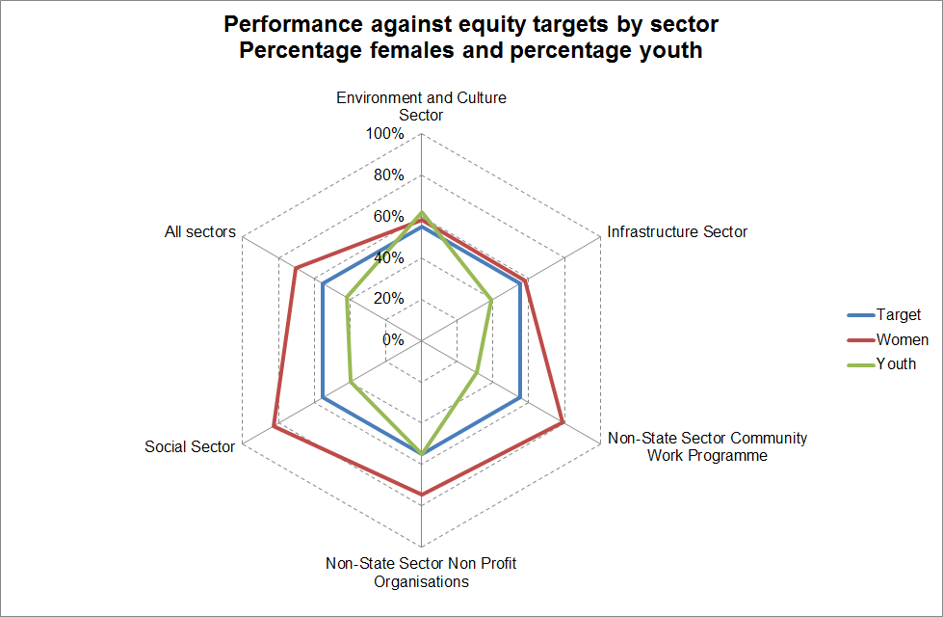
District & Metro Municipal Progress

Slide 41
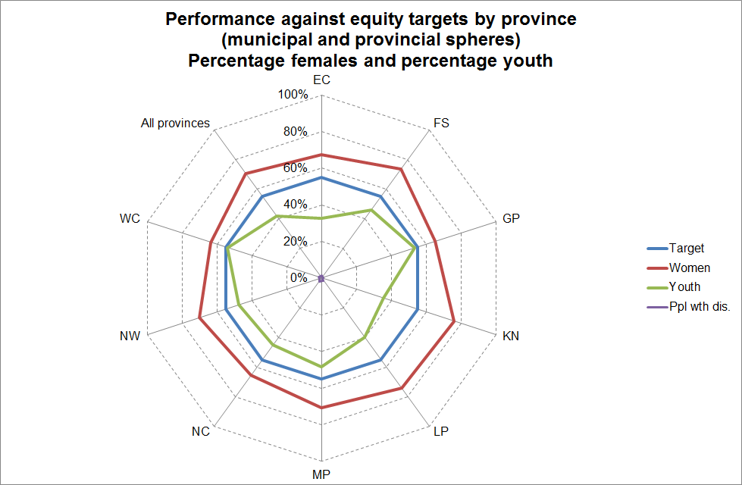

Slide 42
Training Performance

Slide 43
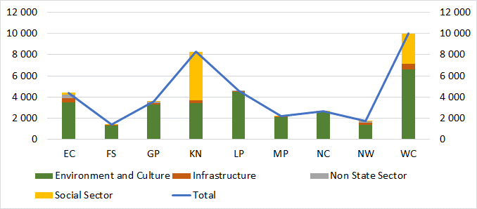
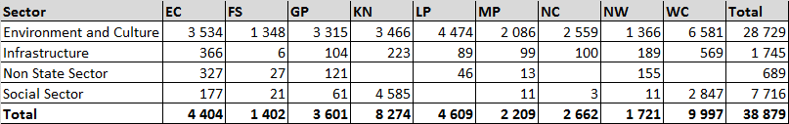
Training in Q2 2018/19
Non-NSF funded Training (Number of persons trained)

Slide 44
NSF Training Report
Short Course - Financial Sector Conduct Authority
Province | Number People Trained | Women | Youth
EC | 432 | 306 | 220
FS | 378 | 301 | 269
GP | 418 | 347 | 248
KN | 377 | 218 | 164
LP | 403 | 279 | 246
MP | 6 | 3 | 6
NC | 110 | 65 | 64
NW | 640 | 491 | 362
WC | 499 | 343 | 346
 | 3 263 | 2 353 | 1 925

Slide 45
NSF Training Report
Artisan Development Programme
Province | Number People Trained | People Trained Women | People trained Youth
EC | 19 | 10 | 16
FS | 1 |  | 1
GP | 4 | 2 | 3
KN | 16 | 4 | 14
LP | 7 | 2 | 7
MP | 1 | 1 | 1
WC | 7 | 5 | 7
Total | 55 | 24 | 49

Slide 46
Sample of current project outputs
(2018/19)

Slide 47
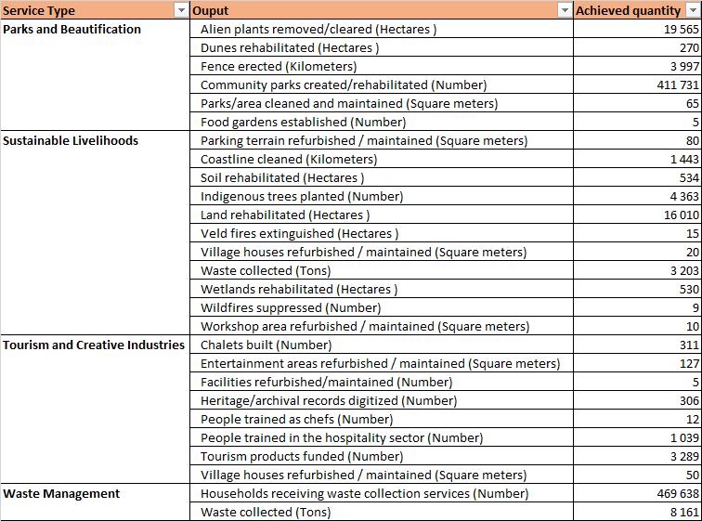
Sample of outputs in 2018/19
Environment and Culture Sector

Slide 48
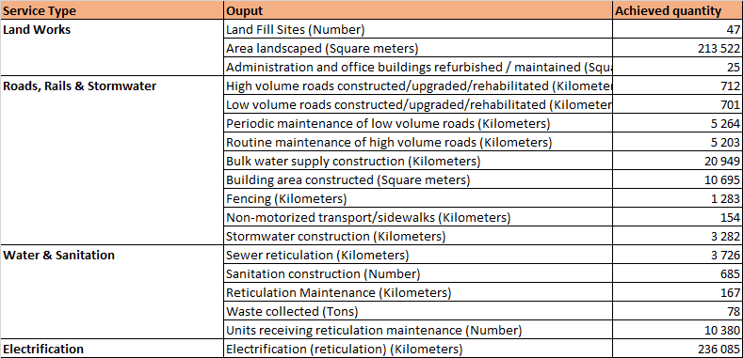
Sample of outputs in 2018/19
Infrastructure Sector

Slide 49
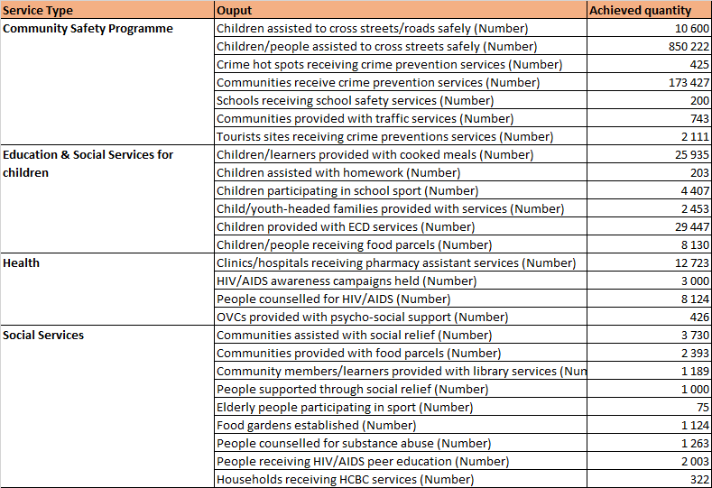
Sample of outputs in 2018/19
Social Sector

Slide 50
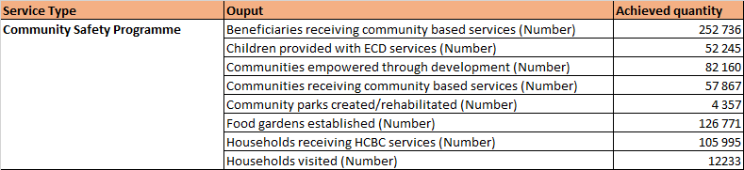
Sample of outputs in 2018/19
Non-State Sector

Slide 51
Recurring Key Programme Challenges
Non-reporting of WOs created through own funding (Municipal Infrastructure Grant) by public bodies. Municipalities don’t incorporate EPWP principles during their planning and budget processes.
Poor reporting by key programmes, leading to under-reporting and audit findings
Lack of sufficient commitment from senior officials to programme implementation by the majority of public bodies

Slide 52
Strategic Intent of EPWP
as Part of Public Employment Programmes
Public Employment Programmes (PEPs) have a long history of being utilised to address such as labour market disruptions and recession.
It aims to draw significant numbers of unemployed people into productive work accompanied by training.
Internationally, PEPs are seen as part of on-going employment and social protection policies used to create short-medium employment opportunities for vulnerable groups in society.
The EPWP is a nationwide programme covering all spheres of government and state-owned enterprises
The programme involves re-orientating line function budgets & conditional grants for govt. expenditure to result in creation of work opportunities
The GDS agreed that EPWP must not displace existing permanent jobs and opportunities must be on real demand for services.
EPWP was introduced in 2003 as one of government’s major public employment programme under the Anti-Proverty Strategy.

Slide 53
The “trilemma” facing EPWP – a reality
Social Protection (income)
Provision of Assets & Services
Employment
EPWP’s development contribution comes through providing all three of these outcomes- but there are trade-offs involved when one tries to maximize one
National Minimum Wage and the exemption of EPWP
EPWP wages and the fear of job displacement
Challenge to meet the EPWP Phase 3 targets (WO, Youth and People with Disability)
Scaling up EPWP during Phase 4 while we can’t meet the Phase 3 targets

Slide 54
Thank You!
Enquiries:
Dr. Eric Nndavheleseni Musekene
Chief Director: EPWP Monitoring and Evaluation
Expanded Public Works Programme
Address: Room 438. 4th floor, 266 Pretorius Street, Centre Walk Office East Block
Tel: 012 492 1470
Cell: 082 739 9549
Email: eric.musekene@dpw.gov.za

